Slide 1

Migration and its discontents
WOMBAT Conference
28 November 2019
Gabriela D’Souza
Senior Economist, CEDA

Slide 2
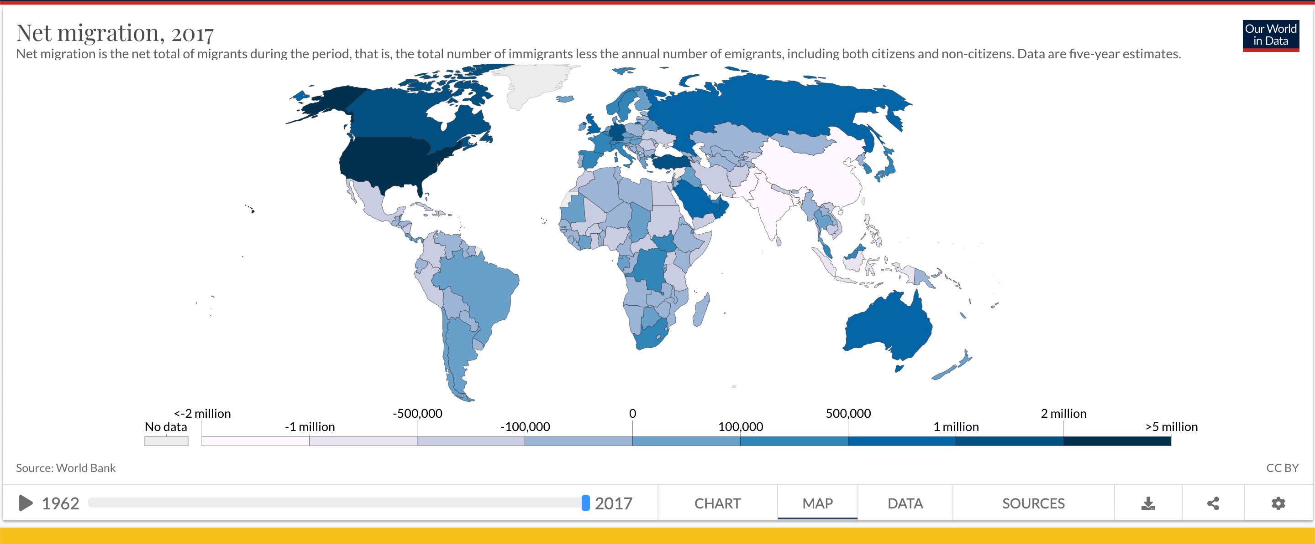
Migration through the years

Slide 3
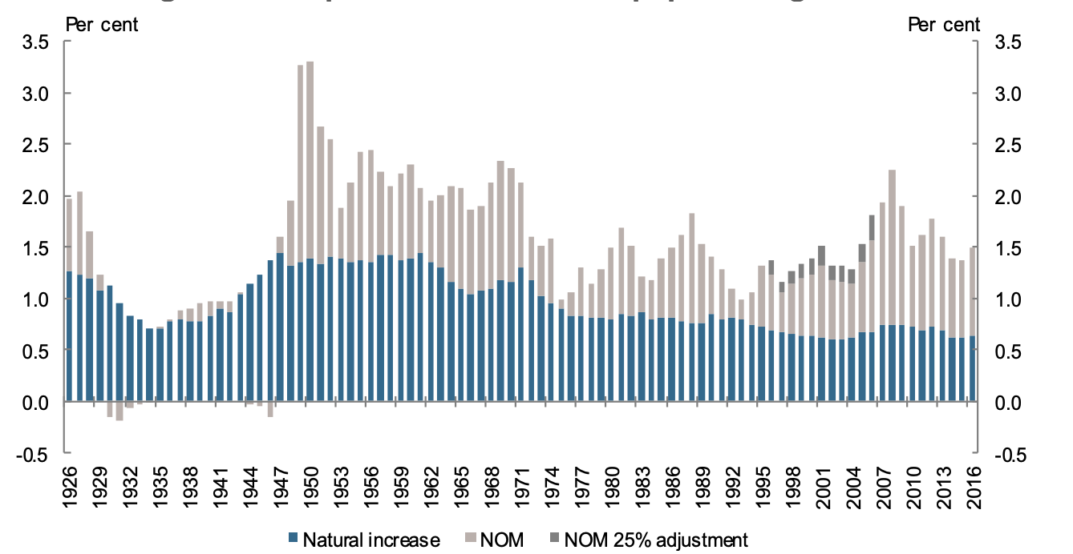
Net overseas migration (Australia)
Source: Treasury (2018) Shaping a Nation

Slide 4
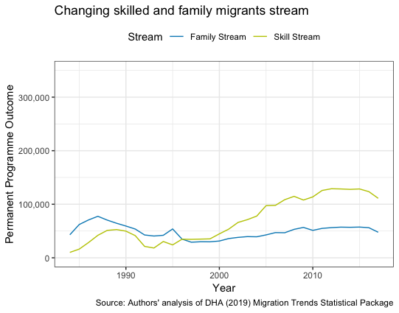
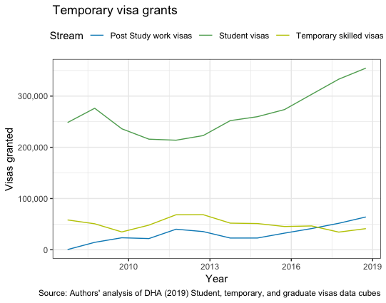
Migrants to Australia over time

Slide 5
Policy questions
How does migration affect the local economy?
Do migrants have positive outcomes?
Do migrants’ children have successful outcomes?
Do immigrants displace local workers (a question more for democracies historically)?

Slide 6
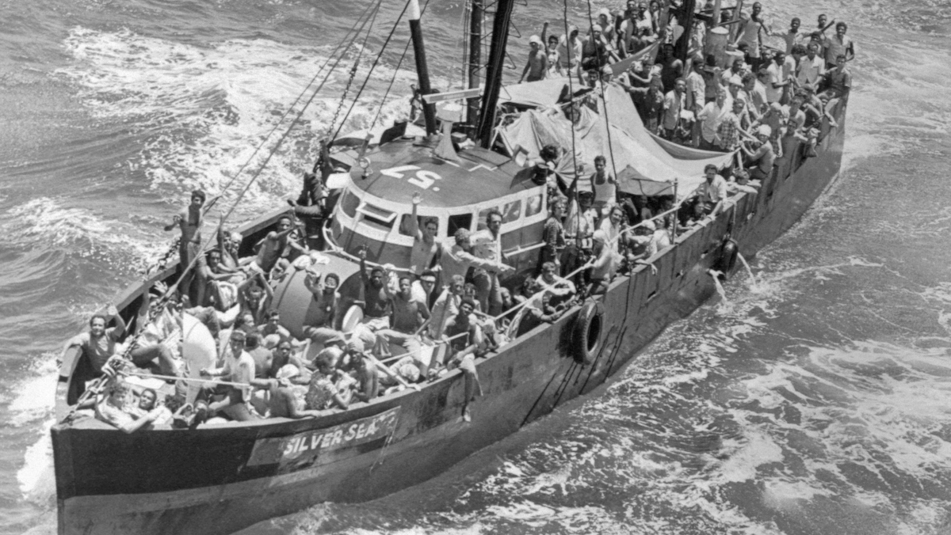
Mariel boatlift

Slide 7
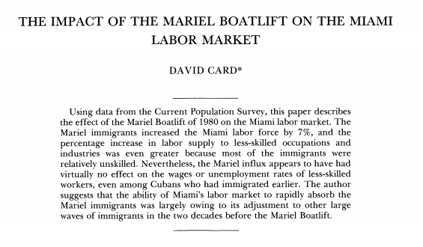
Mariel Boatlift (rinse repeat)
Card (1990)
Clemens and Hunt (2017)
Angrist and Kreuger (1999)
Peri and Yasenov (2015)
Peri and Yasenov (2015 rev. 2017)
Disagree
Agree
Borjas (2016)

Slide 8
The point of that exercise
Stop using the Mariel Boatlift
The effects were either positive and small, negative and small, or n not statistically significant
Academics have strongly held views
Natural experiments are hard to come by

Slide 9
Where does that leave us?

Slide 10

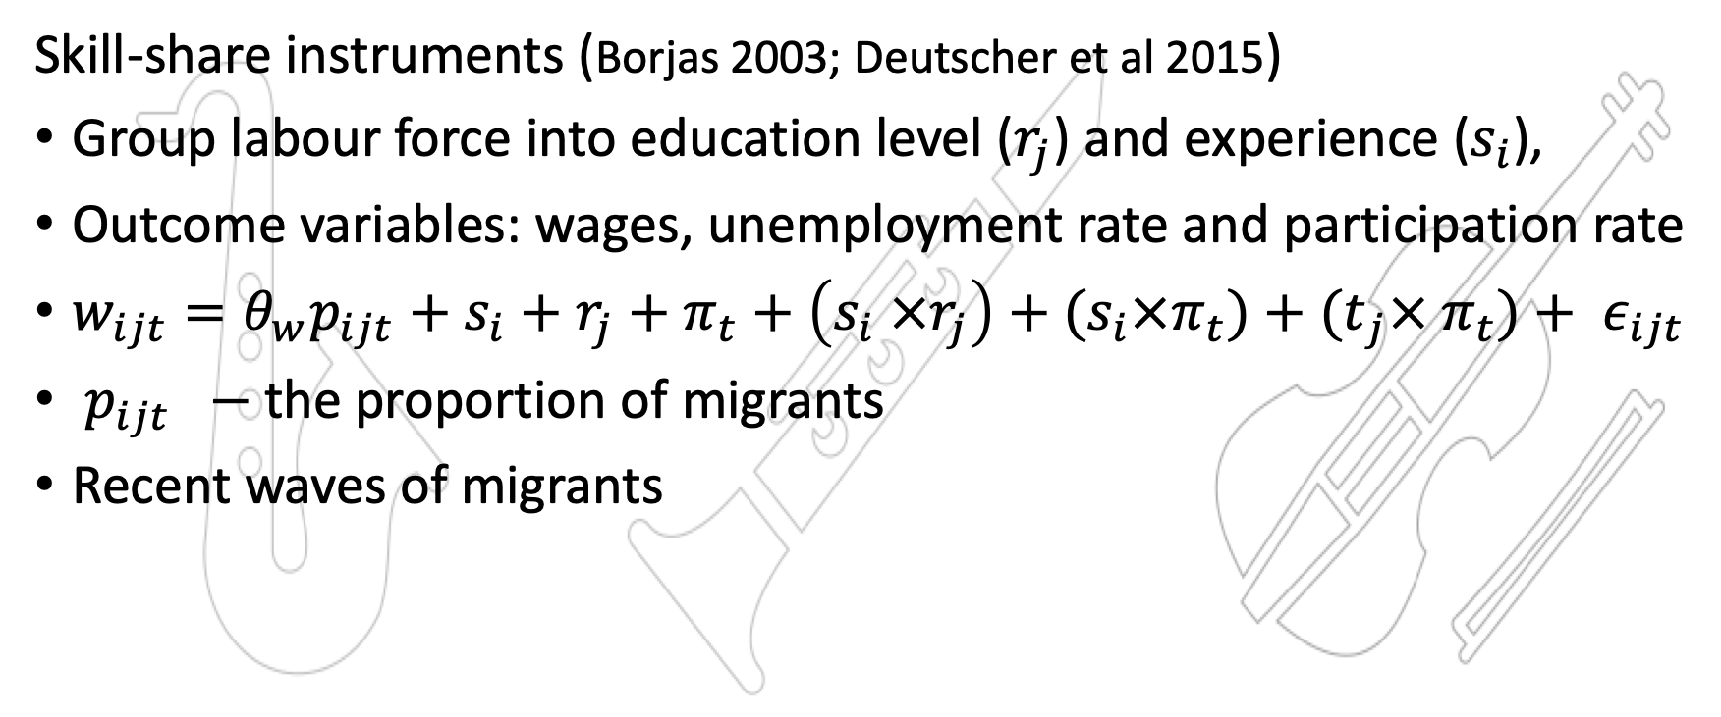
Instruments
Skill-share instruments (Borjas 2003; Deutscher et al 2015)
Group labour force into education level ($r_{j}$) and experience ($s_{i}$),
Outcome variables: wages, unemployment rate and participation rate
$w_{ijt}=θ_{w}p_{ijt}+s_{i}+r_{j}+π_{t}+\left(s_{i} ×r_{j}\right)+(s_{i}×π_{t})+{(t}_{j}× π_{t})+ ε_{ijt}$
$p_{ijt} −$ the proportion of migrants
Recent waves of migrants

Slide 11
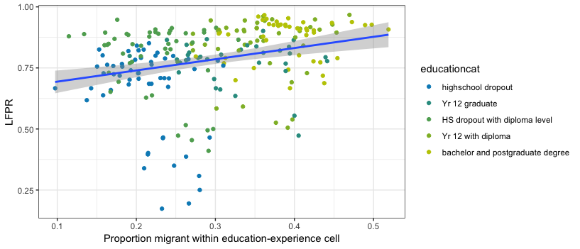
Relationship between migrant proportion and participation rate of local workers
Source: Author’s calculations using ABS Survey of Income and Housing (2003-16)

Slide 12
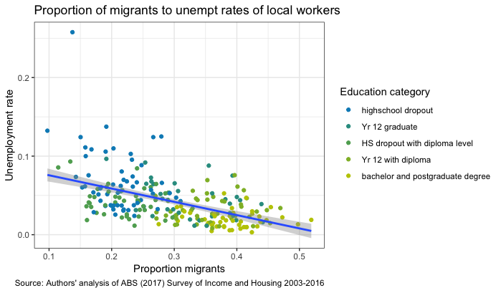
Unemployment rate and proportion of migrants

Slide 13
Results
Increase in proportion of migrants
associated with a increase in annual wages
associated with an increase in labour force participation rate
negatively correlated with unemployment rates
Full paper available here: https://www.ceda.com.au/CEDA/media/General/Publication/PDFs/TemporaryMigrationAppendix.pdf

Slide 14

“The effect of low skilled migration on low-skilled wages is zero. Even when you have big waves of migrants, the effects are zero.
And it’s therefore not really a moral argument It’s not “I should be for migration because I’m a good person; despite the fact that it’s going to hurt us”. It should be “look, the economic impacts are going to be rather small”. ”
Esther Duflo on BBC Ways to change the World (https://www.channel4.com/news/series-3-episode-27-esther-duflo)

Slide 15
Conclusion
So contentious (yet seemingly settled)! Why?
Political economy reasons
Lived experience/ the power of anecdote
Lack of data
Lack of evidence

Slide 16
References
Altonji, J. G., & Card, D. (1991). The effects of immigration on the labor market outcomes of less-skilled natives. In Immigration, trade, and the labor market (pp. 201-234). University of Chicago Press.
Borjas, G. J. (2003). The labor demand curve is downward sloping: Reexamining the impact of immigration on the labor market. The quarterly journal of economics, 118(4), 1335-1374.
Borjas, 2017. "The Wage Impact of the : A Reappraisal," ILR Review, vol 70(5), pages 1077-1110.
Breunig, R., Deutscher, N., & To, H. T. (2017). The Relationship between Immigration to Australia and the Labour Market Outcomes of Australian‐Born Workers. Economic Record, 93(301), 255-276.
Card, D., & Peri, G. (2016). Immigration economics by George J. Borjas: a review essay. Journal of Economic Literature, 54(4), 1333-49.
Card, D. (2001). Immigrant inflows, native outflows, and the local labor market impacts of higher immigration. Journal of Labor Economics, 19(1), 22-64.Clemens and Hunt
Clemens, M. A., & Hunt, J. (2019). The labor market effects of refugee waves: reconciling conflicting results. ILR Review, 72(4), 818-857.
Giovanni Peri & Vasil Yasenov, 2019. "The Labor Market Effects of a Refugee Wave," Journal of Human Resources, vol 54(2), pages 267-309.
Okkerse, L. (2008). How to measure labour market effects of immigration: A review. Journal of Economic Surveys, 22(1), 1-30.

Slide 17
Thank you
Email: gabriela.dsouza@ceda.com.au

